Slide 1
Valuation: Aims and purpose
What is value?
History of value
Neo-classical revolution
Types of value
Why value the environment
Applications of monetary valuation
Cost-benefit analysis, regulatory targets
Compensation
Accounting

Slide 2
0 Introduction
1 Social choice
2 Externalities and public goods
3 Decision analysis
4 Valuation: Aims and purpose
5 Valuation: Revealed preferences
6 Valuation: Stated preferences
7 Direct regulation
8 Market-based instruments
9 Complications with instruments
10 Growth and the environment
11 Green accounting

Slide 3
Valuation: Aims and purpose
What is value?
History of value
Neo-classical revolution
Types of value
Why value the environment
Applications of monetary valuation
Cost-benefit analysis, regulatory targets
Compensation
Accounting

Slide 4
“Theories of value have formed the theoretical core of every major school of economic thought.”
— Patterson, 1998
Notes:
In fact…
Why so important? Because without an understanding of value, you really can't explain what's going on in the economy -- who is exchanging how much of what with whom, and why.
Deep background.

Slide 5
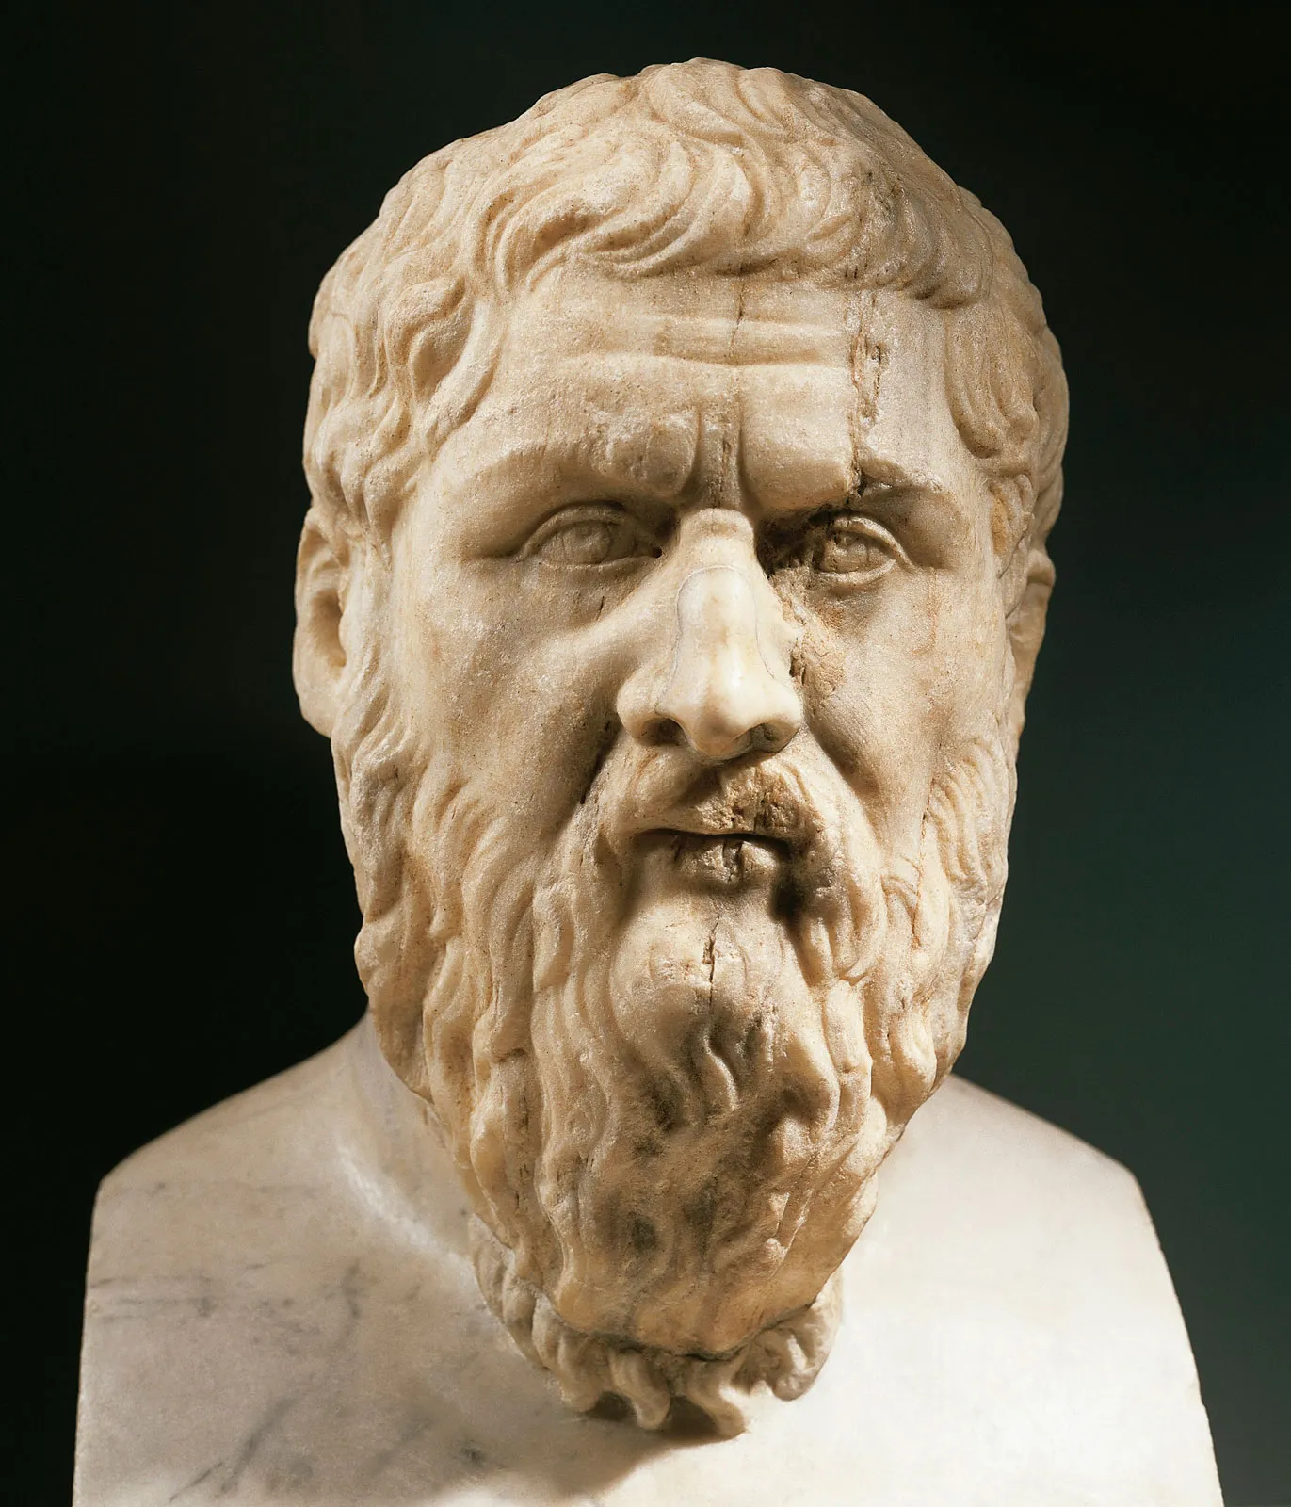
Value in use
Value in exchange
Notes:
Scholars have in fact been kicking around ideas about value for centuries -- long before the beginnings of economics as a discipline.
...
Aristotle made a distinction between value in use (what something is worth) and value in exchange (or its price).

Slide 6


Notes:
People through the ages have noticed that these aren’t necessarily highly correlated.
This is known as the water/diamonds paradox.
(Water: useful, cheap; diamonds, useless, expensive).

Slide 7
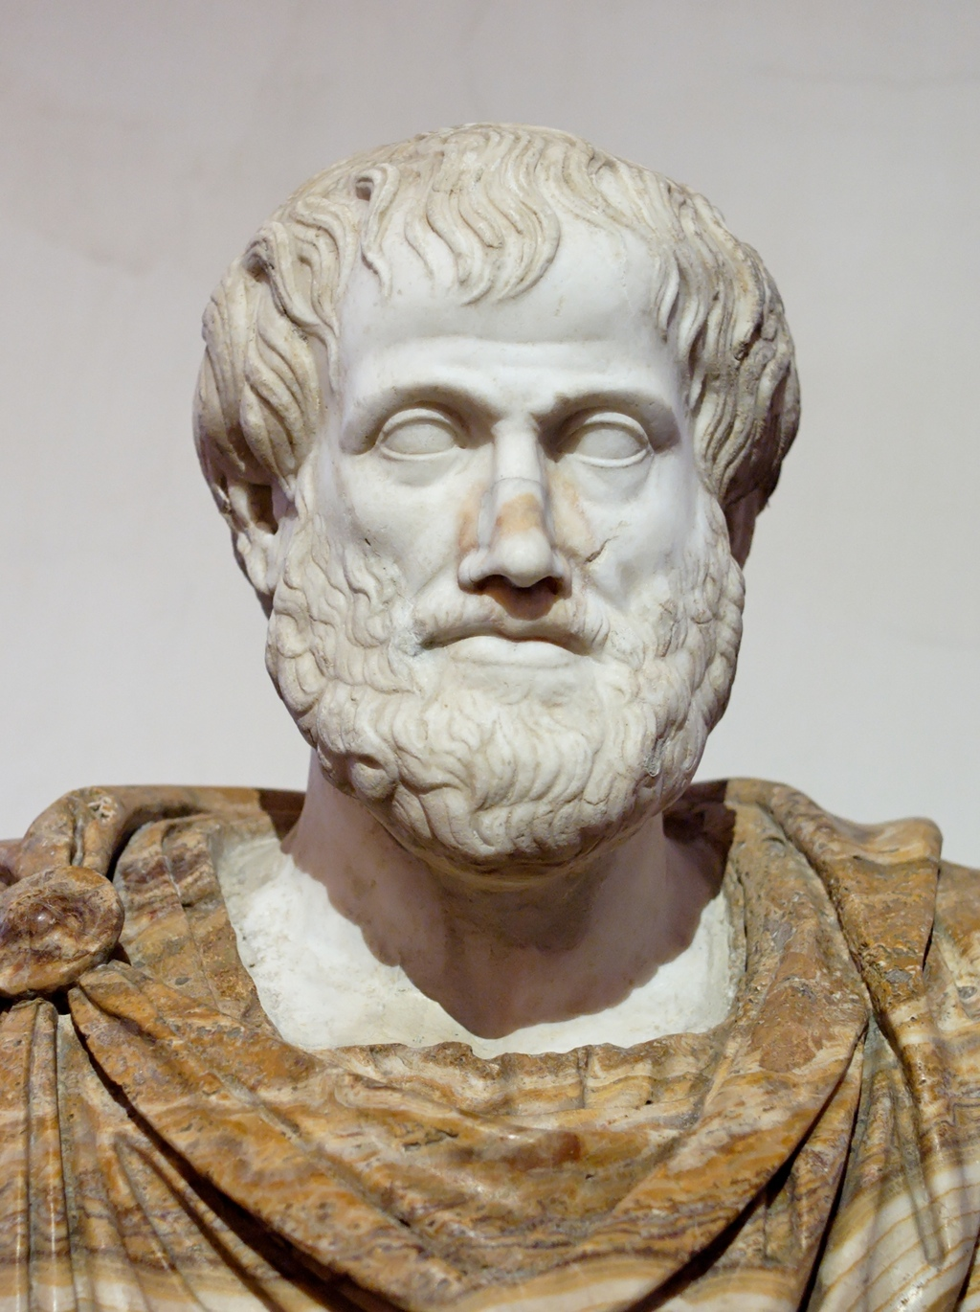
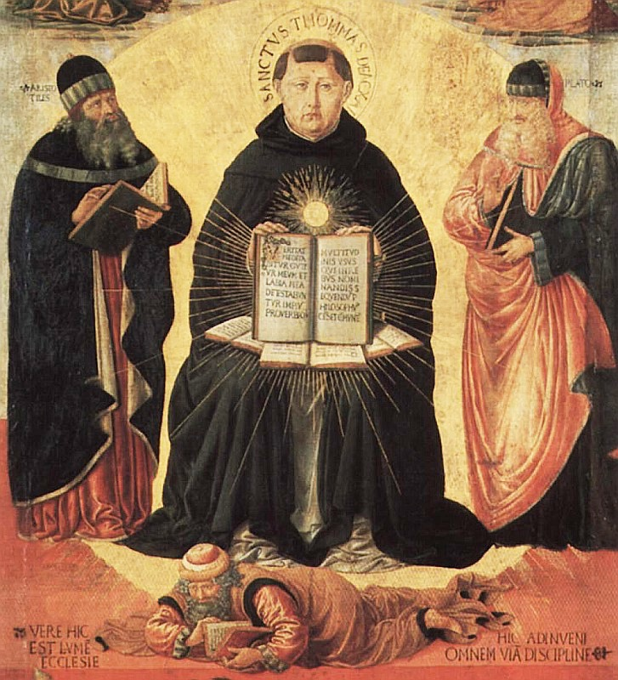
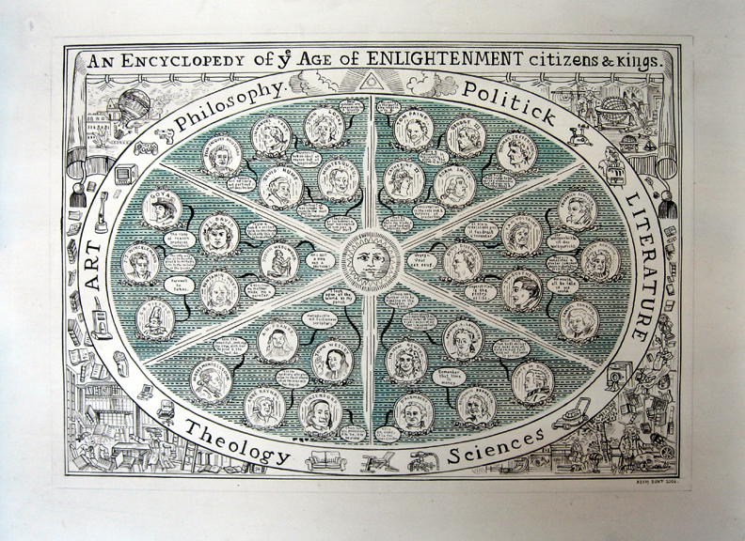
Short-run: demand and supply, value in exchange
Notes:
Classical, medieval and enlightenment scholars all understood that prices were affected in the short-term by demand and supply.

Slide 8
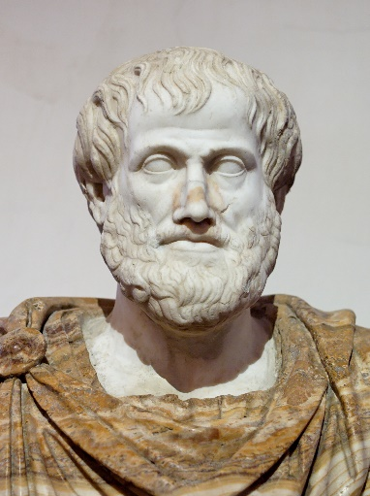


Ancient and mediaeval values
Aristotle (fl. 350 BC)
Value is what it should be worth
Philosophy sets the intrinsic value
Augustine (fl. 400)
Value is what God thinks it’s worth
Theology sets the intrinsic value
Thomas Aquinas (fl. 1250)
What Augustine said

Slide 9
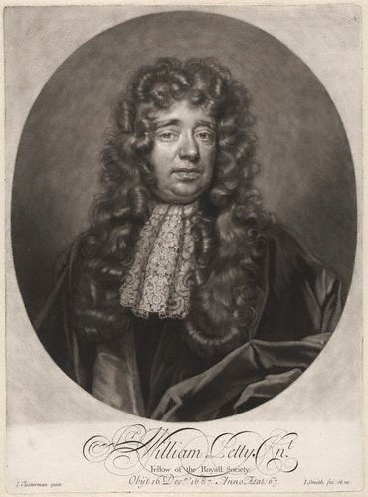
“Labour is the Father and active principle of Wealth, as Lands are the Mother”
— Petty, 1662
Notes:
For example, Britain’s William Petty thought land and labour were the key.

Slide 10
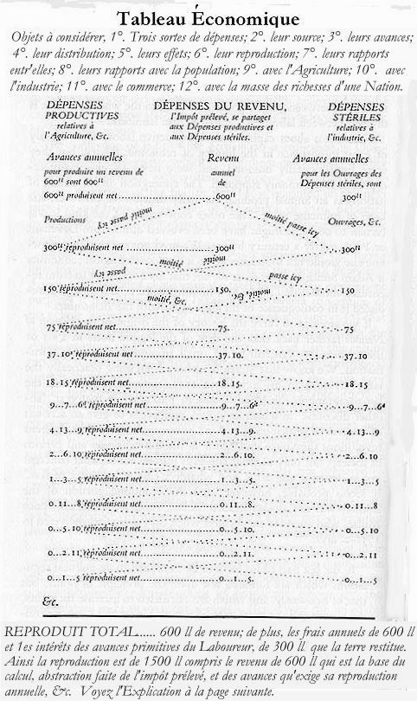
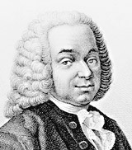
Quesnay emphasized land
Laws of nature are God-given
Agriculture touches nature
Therefore, croplands are valuable
Other economic assets are not
Quesney was landed gentry,
served nobility and royalty
Notes:
A century later, the Physiocrats across the Channel in France emphasized land alone.
Quesnay's 'Tableau économique', shown here, was supposed to demonstrate how value circulates through the community from its origins in agriculture.

Slide 11
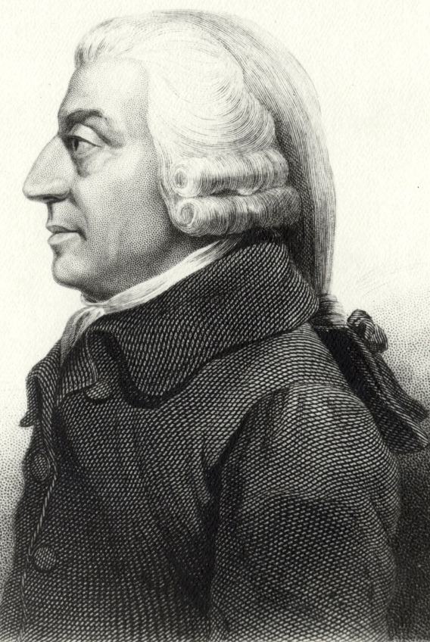
“If among a nation of hunters, for example, it usually costs twice the labour to kill a beaver which it does to kill a deer, one beaver should naturally exchange for or be worth two deer.”
— Adam Smith
Notes:
A short time later still, Adam Smith proposed a pure labour theory of value.
…
But Smith only held this out as applying to humans in a prehistoric state of nature.

Slide 12

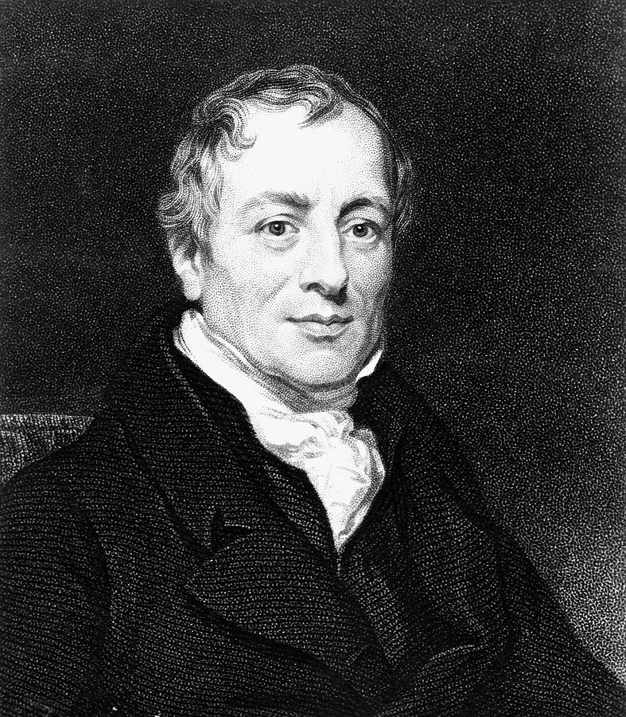
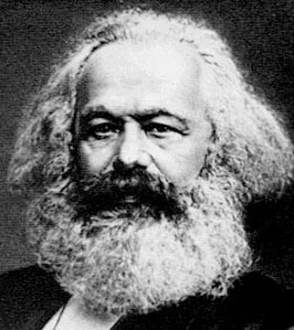
Ibn Khaldun
Ricardo
Marx
Notes:
Ricardo and Marx also took up and developed this idea of a labour theory of value.

Slide 13
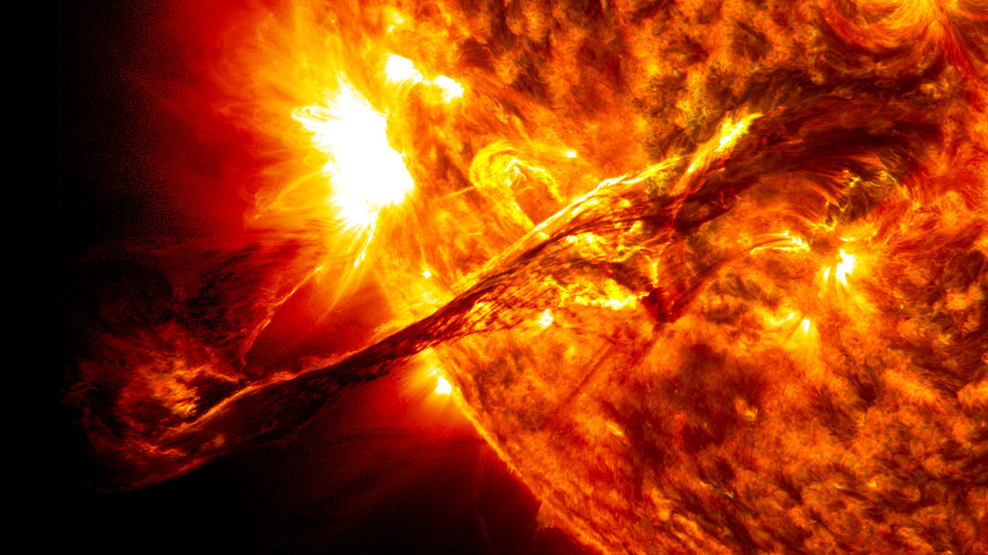
Embodied energy theories of value
e.g. Georgescu-Roegen, Costanza, Odum
Photo: NASA Solar Dynamics Observatory/AIA/Goddard Space Flight Center
Notes:
Since the 1960s, some ecologists and ecological economists — particularly around the oil crises of the 1970s — have looked for explanations of value in terms of the energy embodied in commodities.
Which is essentially another sort of natural or intrinsic value theory.

Slide 14
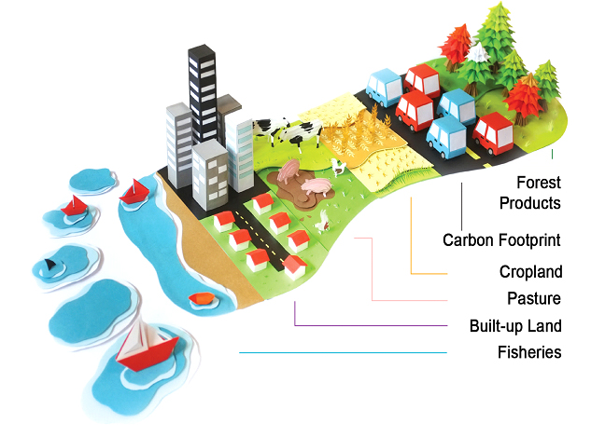
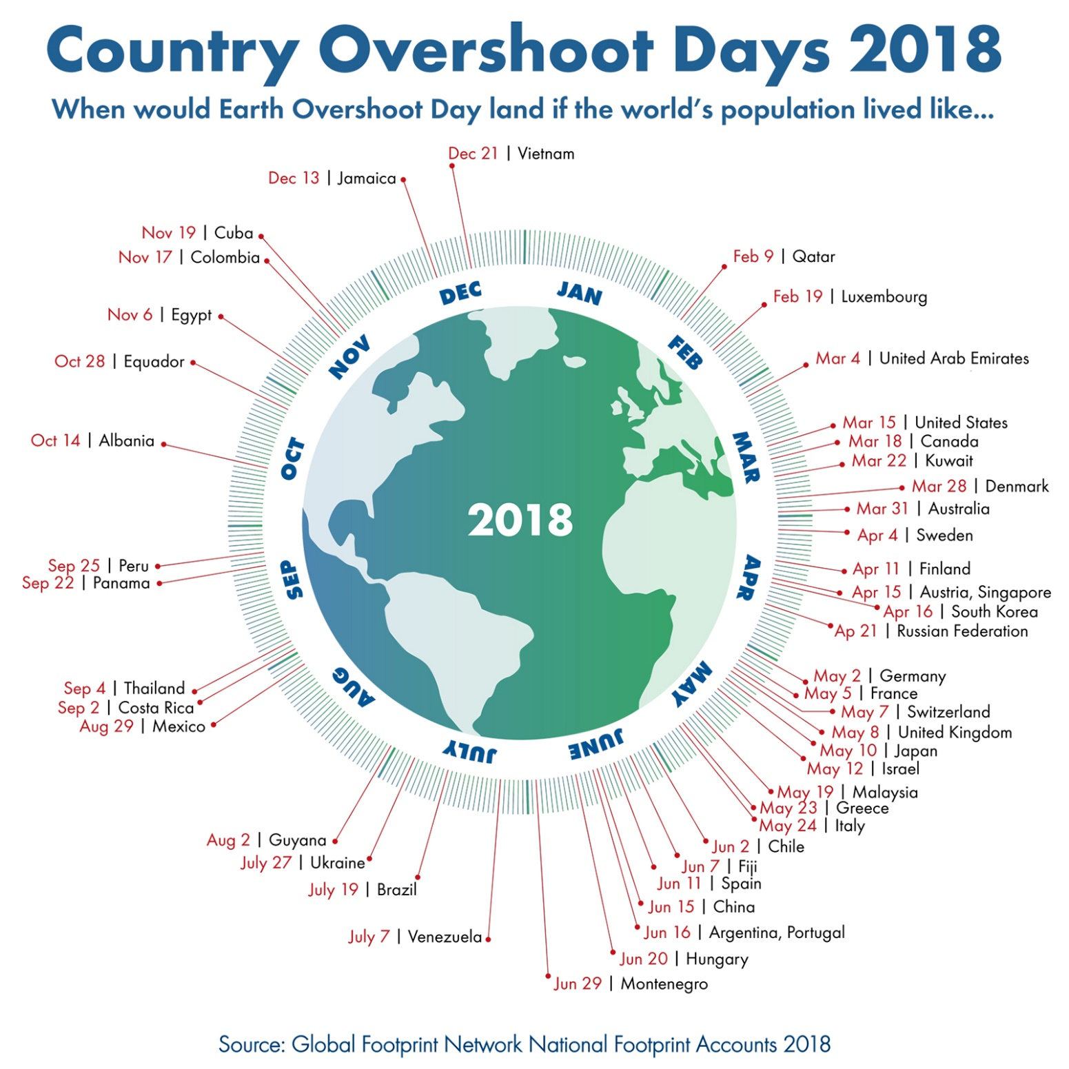


Rees and Wackernagel return to the Physiocrats’ land theory of value

Slide 15
Values in history
Values-in-use are set by
Ethical considerations
Religious considerations
Land
Labour
Energy
There is an absolute yardstick that determines what the value should be
If prices (value-in-exchange) deviate from values-in-use, that is because the market is immoral
Classical economists argued that, because the market equilibrium is a Pareto optimum and market prices reflect labour content, the market is moral

Slide 16
Valuation: Aims and purpose
What is value?
History of value
Neo-classical revolution
Types of value
Why value the environment
Applications of monetary valuation
Cost-benefit analysis, regulatory targets
Compensation
Accounting

Slide 17
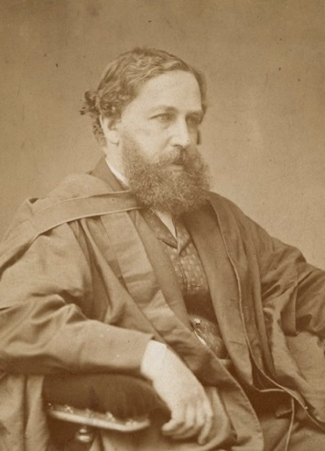
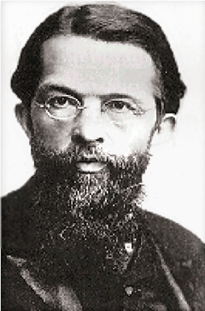

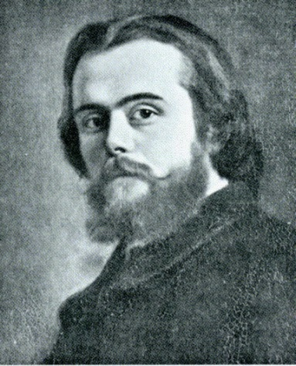
Neo-Classical Revolution
Value is relative: Value in use equals value in exchange at the margin
Consumer sovereignty
We take utility functions as given
Knowable up to an affine transformation
Market is amoral
Values depend on context
Supply, demand
Culture, custom, taste
Uncertainty: Something that is uncertain is worth less, an uncertain loss is worth more
Uniqueness: Something that is unique is worth more
Notes:
Callantians

Slide 18
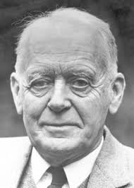
Measures of value
Willingness to pay (WTP)
Hicksian equivalent variation
How much I value something I don’t have is measured by the most that I will give up in order to gain it
Supermarket
Willingness to accept compensation (WTAC)
Hicksian compensating variation
How much I value something I do have is measured by the least I must gain in order to give it up
Damage
Notes:
That gives us two key measures of value:
First, …

Slide 19
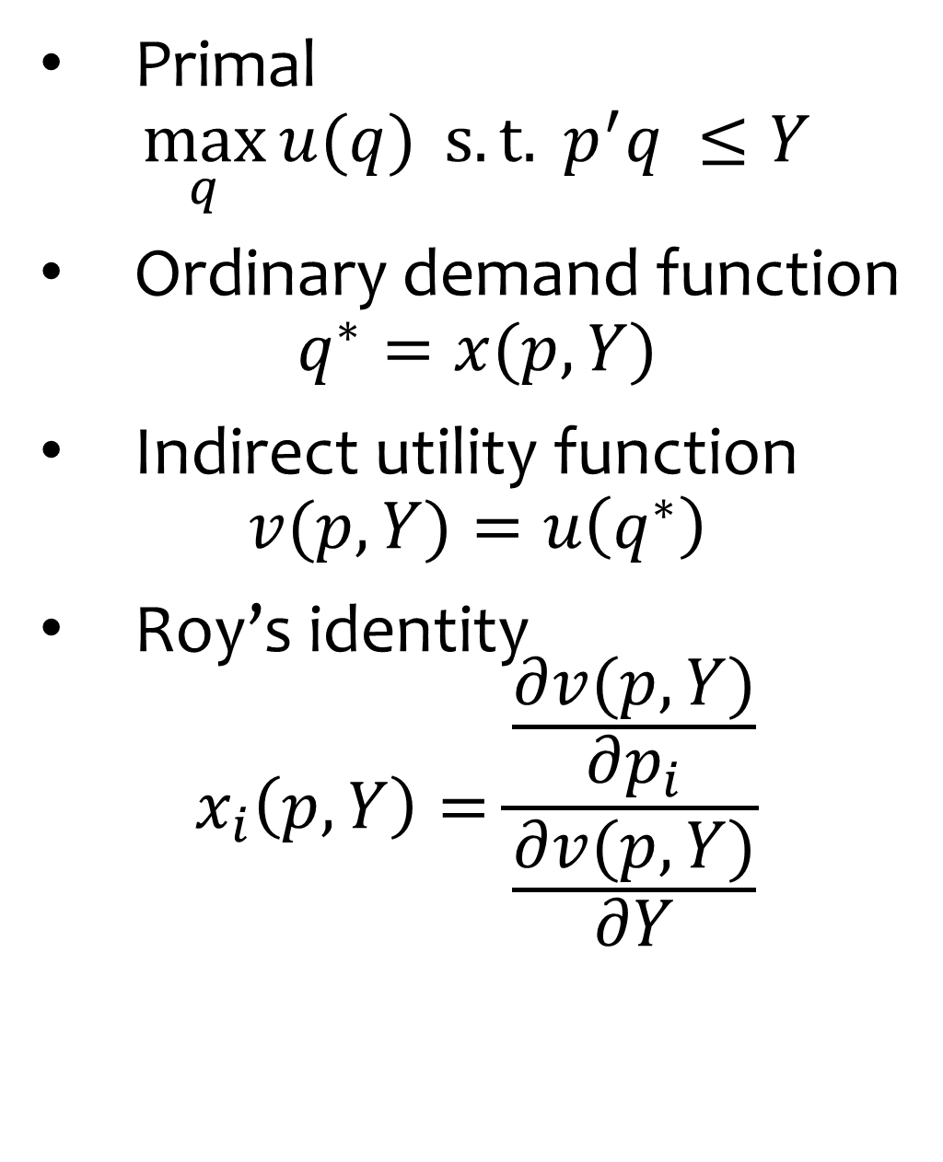
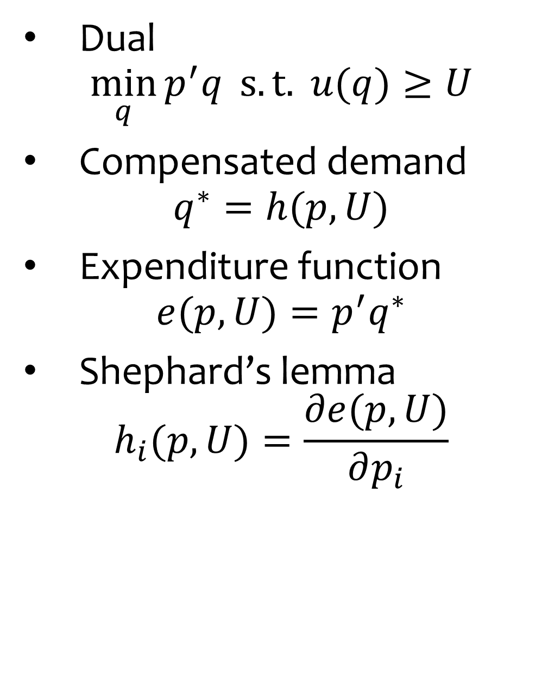
Hicks made precise
Primal
$$\max_{q}{u(q)} s.t. { p}^{′}q ≤Y$$
Ordinary demand function
$$q^{∗}=x(p,Y)$$
Indirect utility function
$$v(p,Y)=u\left(q^{∗}\right)$$
Roy’s identity
$$x_{i}\left(p,Y\right)=\frac{\frac{∂v(p,Y)}{∂p_{i}}}{\frac{∂v(p,Y)}{∂Y}}$$
Dual
$$\min_{q}{p^{′}q} s.t. u(q)≥U$$
Compensated demand
$$q^{∗}=h(p,U)$$
Expenditure function
$$e(p,U)=p^{′}q^{∗}$$
Shephard’s lemma
$$h_{i}(p,U)=\frac{∂e(p,U)}{∂p_{i}}$$
Notes:
That gives us two key measures of value:
First, …

Slide 20
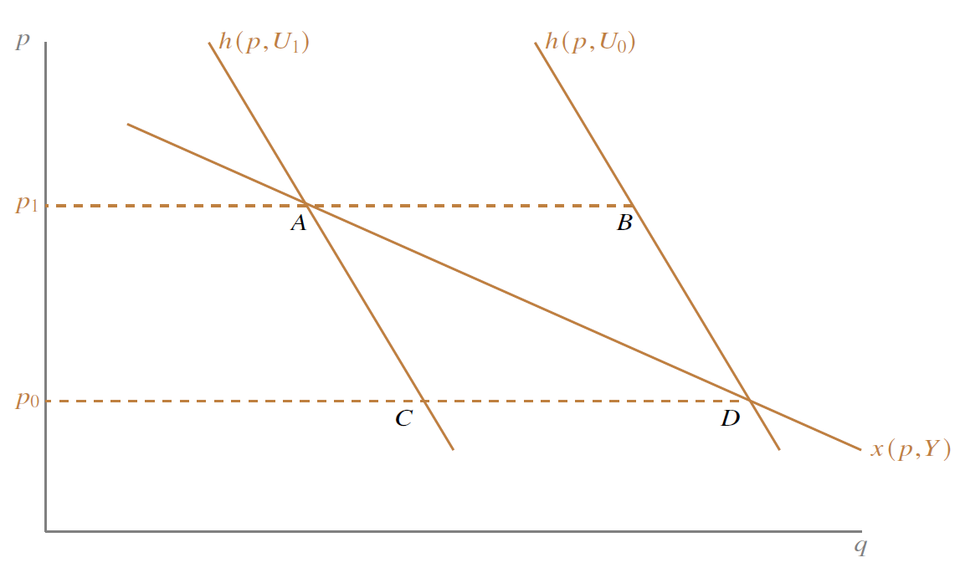
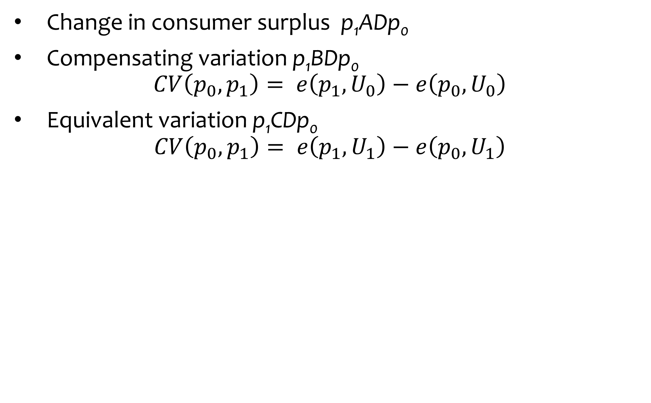
Hicks made precise
Change in consumer surplus p₁ADp₀
Compensating variation p₁BDp₀
$$CV\left(p_{0},p_{1}\right)= e\left(p_{1},U_{0}\right)−e\left(p_{0},U_{0}\right)$$
Equivalent variation p₁CDp₀
$$CV\left(p_{0},p_{1}\right)= e\left(p_{1},U_{1}\right)−e\left(p_{0},U_{1}\right)$$
Notes:
That gives us two key measures of value:
First, …

Slide 21
Valuation: Aims and purpose
What is value?
History of value
Neo-classical revolution
Types of value
Why value the environment
Applications of monetary valuation
Cost-benefit analysis, regulatory targets
Compensation
Accounting

Slide 22
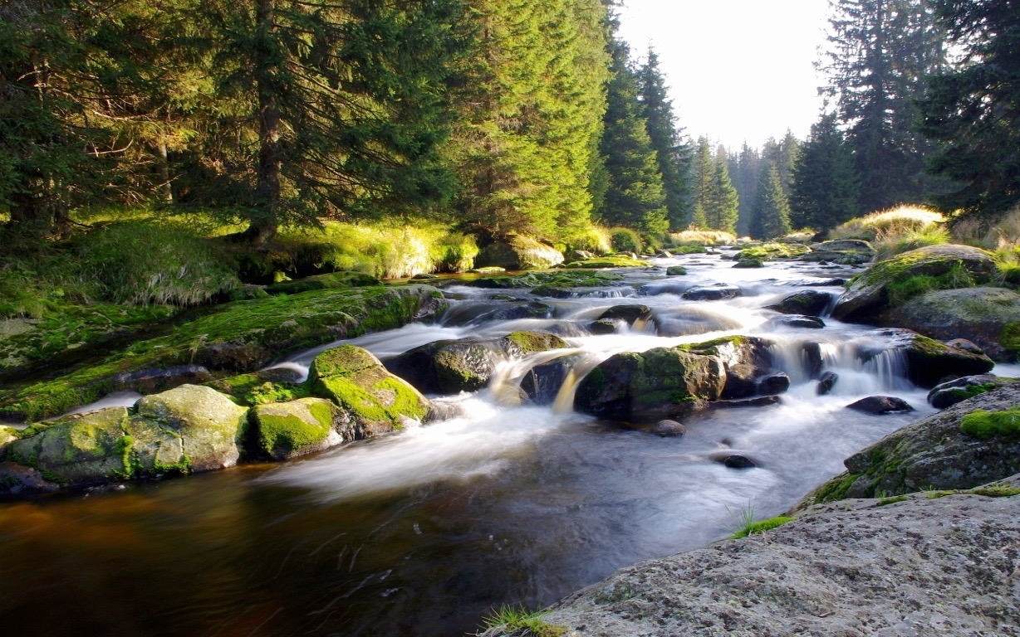
Photo: themes.com

Slide 23
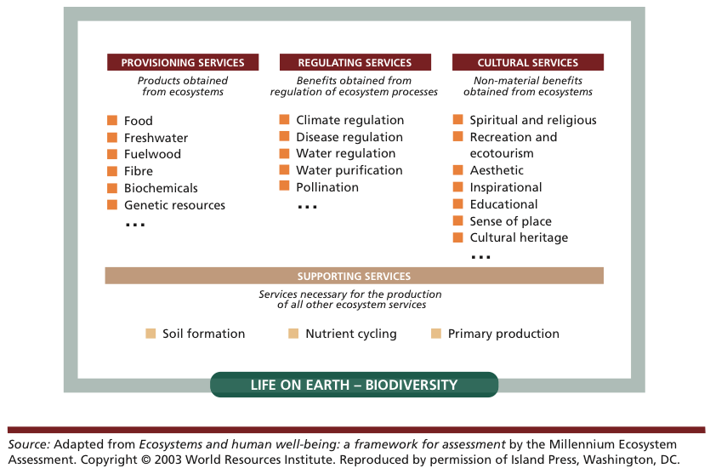
Notes:
And all these things too: a more systematic classification of things we get from our environment …
…
Under normal circumstances, these things have no production costs and, crucially, no market price. A gift of God or Nature, as scholars of previous centuries saw it.
No market price … Does that mean these things have no value? Of course not.

Slide 24
Consumptive/extractive
Direct
Use values
Non-consumptive
Indirect
Total Economic Value (TEV)
Option value
Option values
Quasi-option value
Bequest
Others’ use
Non-use values
Altruism
Pure existence
Notes:
It’s down to what environmental economists call TEV.
TEV is the sum of lots of separate individual values [click] …

Slide 25
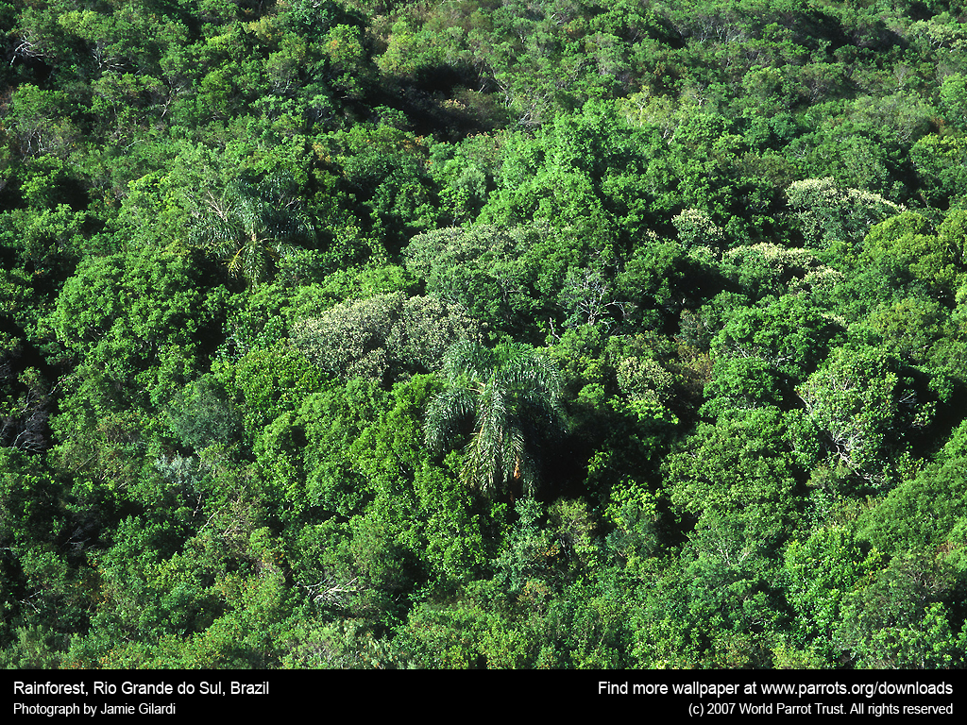
Photo: World Parrot Trust
Notes:
So, let’s say I’m planning to clear a million hectares of tropical forest.
Why would I be doing this? (…)
- Timber
- Alternative land use (e.g. cattle ranching)
What’s the value of this to me? (…)
- One-off timber sales + income from alternative land use
What’s the value of this to society? (…)
- My values
- Minus the rest of TEV, incl. carbon storage

Slide 26
Consumptive/extractive
Direct
Use values
Non-consumptive
Indirect
Total Economic Value (TEV)
Option value
Option values
Quasi-option value
Bequest
Others’ use
Non-use values
Altruism
Pure existence
Notes:
[Don’t rehearse names]
These names are not all that helpful on their own, so let’s explain using some examples …

Slide 27
e.g. rainforest
Consumptive/extractive
timber, fuelwood, nuts
Direct
Use values
Non-consumptive
recreation, amenity, cultural/religious
Indirect
carbon storage, watershed protection,
soil conservation
Total Economic Value (TEV)
Option value
Option values
possible future tourism
Quasi-option value
biodiversity —pharmaceuticals, …
Bequest
enjoyment by children, descendants
Others’ use
Non-use values
Altruism
enjoyment by others
Pure existence
stewardship, ethics, rights of other species, …
Notes:
Let’s take the TEV of a hectare of rainforest:
…
For timber/nuts might also distinguish renewable and non-renewable extractive uses.
…
[click] Two big ones are timber and carbon storage. Some are one-off (timber). Others are recurring, per hectare, per year.
Pearce & Pearce for actual values. Don’t forget, all values will be marginal -- and contingent on the world having about as much forest as it did when they were calculated. One would expect all of these values to rise as tropical rainforests contract.

Slide 28
Valuation: Aims and purpose
What is value?
History of value
Neo-classical revolution
Types of value
Why value the environment
Applications of monetary valuation

Slide 29
Why value?
If you want to
compare the impacts of environmental damage to the impacts of emission reduction in a cost-benefit analysis;
impose the Pigou tax;
pay for environmental services;
determine how much compensation should be paid; or
include the impacts in the national accounts;
money is the appropriate indicator.

Slide 30
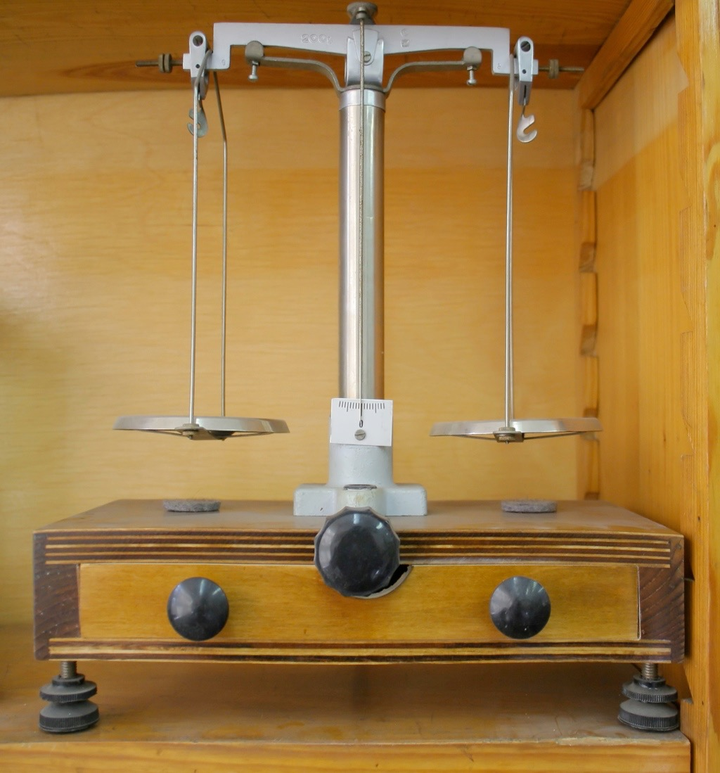
Social CBA
Assesses total social costs and benefits
To anyone — not just commercial costs and returns
See last lecture
?
?
Notes:
(1)
You got a whole lecture on this last week!
So as you know, social CBA tots up the costs and benefits to determine whether something is a good idea.
A key point about CBA is that you want to assess total social costs and benefits monetary and otherwise, of something.
So a CBA done by a logging firm and by the World Bank would (one hopes) look very different.
And so, whatever you're applying social CBA to, you need to attach monetary values to all the impacts — positive and negative — including all environmental impacts (as well as educational impacts, public health impacts, and so on) so that they're considered along with and in the same way as the 'ordinary' inputs (labour, capital, materials) and outputs (goods and services).
And so a large part of the work in an environmental CBA is environmental valuation of the non-market costs and benefits.

Slide 31
Benefit-cost analysis
If an optimum is sought, the marginal external cost function must be estimated, and expressed in money
B
<
A
C
A
CBA: W=X+aY
?
<
B
D

Slide 32
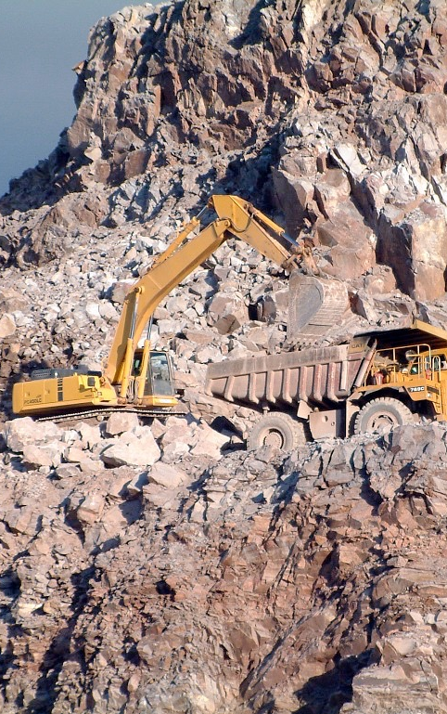
Tax and regulation
Quarrying has externalities
Noise, dust, vibration, water contamination, and visual, heritage and wildlife impacts
For efficient level of quarrying, externalities must be internalised
Notes:
(4)
…
Thus producers of aggregates compensate society for loss of welfare caused.

Slide 33
UK Aggregates Levy
DETR commissioned valuation exercises to assess externalities
Sand + gravel
1998: WTAC = £9/tonne
1999: WTP = £2/tonne
Lower values for other materials
UK Aggregates Levy
Currently £2/tonne for all materials
Notes:
…
Note that WTA is much higher than WTA. Will discuss this later.
…
But note the distribution issue: most of the externalities are suffered by those near the quarries, but the national tax compensates us all equally.

Slide 34
Also …
Landfill Tax
Greenhouse gases, toxicity, noise, odour, visual impact
Air Passenger Duty
Greenhouse gases

Slide 35
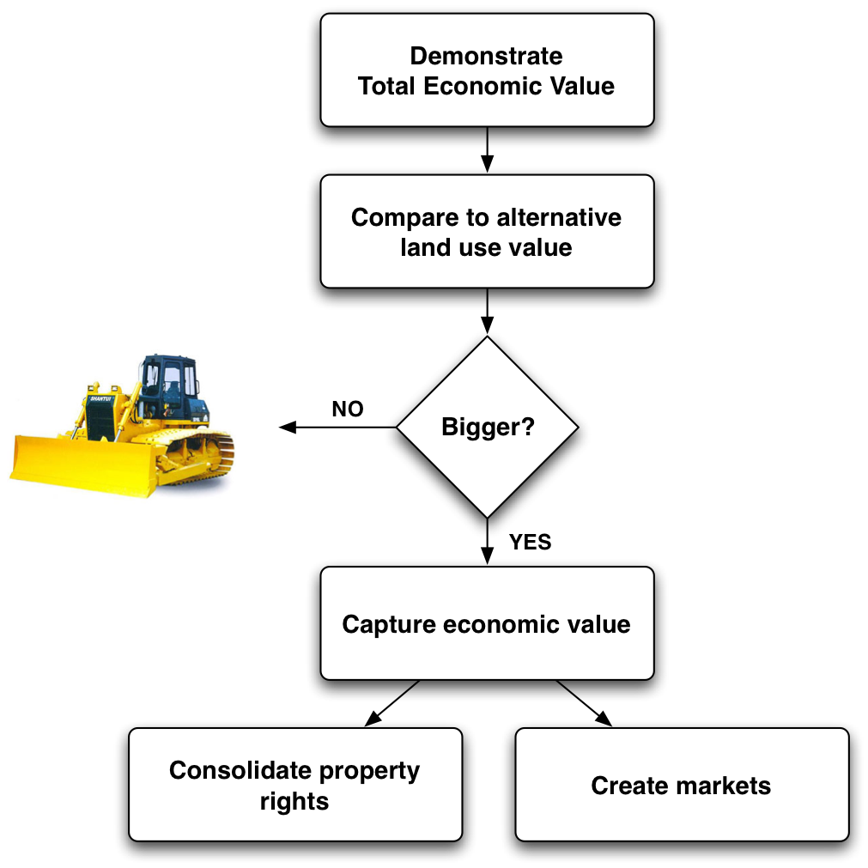
Demonstrate & capture
= a Payment for Environmental Services (PES) scheme, informed by Cost-Benefit Analysis (CBA)
Notes:
Pearce called this demo + capture. The first steps are as discussed just now …
(explain slide) …
How might this work in this case of a rainforest?
Biggest values in carbon storage, so probably concentrate on those.
Individuals or organisations pay the land-owner not to clear the forest.
Might be other options. E.g. sale to pharmaceutical companies (but speculative).
This is a PES scheme, informed by a CBA.

Slide 36
Environmental valuation might save the rainforests
Notes:
And environmental valuation is crucial to this sort of scheme, because it’s the step where we can demonstrate the economic value of the environment, and thus go head to head with other economic arguments.
So. Q: Why value the environment? A: …

Slide 37
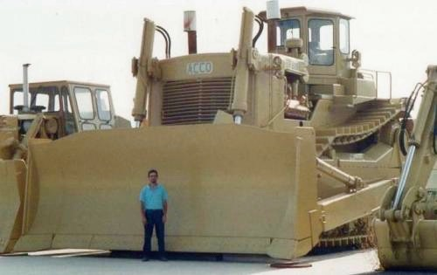
How are you going to stop me?
Legislation & litigation
Compensation
Forest value captured and returned to party with an incentive to clear
Notes:
So: how are you going to stop me?
1. Legislation
Well, possibly. Though, of course, my government might be all for cutting red tape and boosting GDP at any cost (Daly's 'uneconomic growth'). Heck, I might even be the government.
Because many of those component parts of TEV — notably carbon storage — are global. I.e. most of the benefits of conservation are not seen even across the forested nation as a whole.
2. Compensation
Yep. The economic remedy is that the forest's TEV is somehow captured and returned to the party who would otherwise have an incentive to clear it.

Slide 38
Payment for Environmental Services
Holder of property rights over an environmental good is compensated in order to continue flow of environmental services
Internalizing an externality
Recipient generally a farmer or landowner
Coasian bargain
Notes:
(2)
Outlined the basics of a PES scheme in our example about forests.
The holder of property rights over an environmental good — generally a farmer or other landowner — is compensated in order to continue the flow of environmental services.
Way of internalizing what would otherwise be an externality. (Application of the Coase theorem from lecture 3 — free market environmental protection).

Slide 39
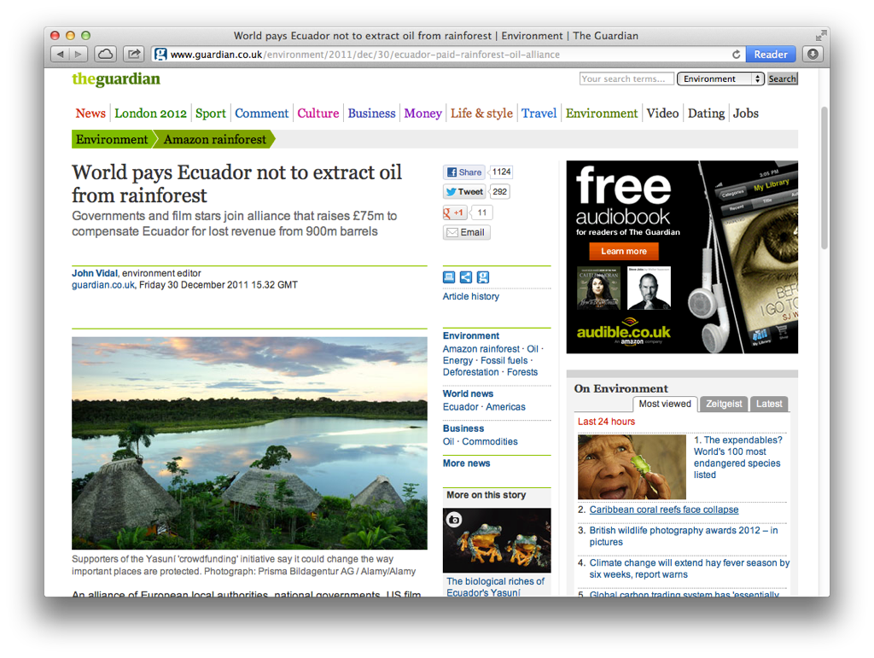
Climate change mitigation
Biodiversity conservation
Watershed services
e.g. Pirampiro, Ecuador
Notes:
In practice there are currently 3 major kinds of PES scheme in the world …
…
Our earlier forest example would probably come under climate and biodiversity. These schemes tend to involve payments from rich countries to poor countries, and are mediated by international organisations (e.g. UN's Global Environment Facility), governments and NGOs. And they do happen [Guardian piece].
By contrast, watershed service schemes are generally pretty local. (And along the lines we spoke about in lecture 3, again, in relation to Evil Corp and discharges into a river).

Slide 40
PES viability
Maximum WTP of beneficiaries of environmental services (“buyers”) > minimum WTA of providers of those services (“sellers”)
Valuation generally informs WTP
Notes:
…
WTA = what they’d otherwise get from their land.
WTP is what we need valuation for.

Slide 41

“nice little forest you got there. Be a real shame if something happenED to it …”
Notes:
PES is pretty much literally a protection racket.
It pays for everyone who has a forest to say they’ll cut it down, and then go round the rest of us asking for money not to do so.
But if the beneficiaries are poor and those paying are rich, looks less unpleasant.

Slide 42
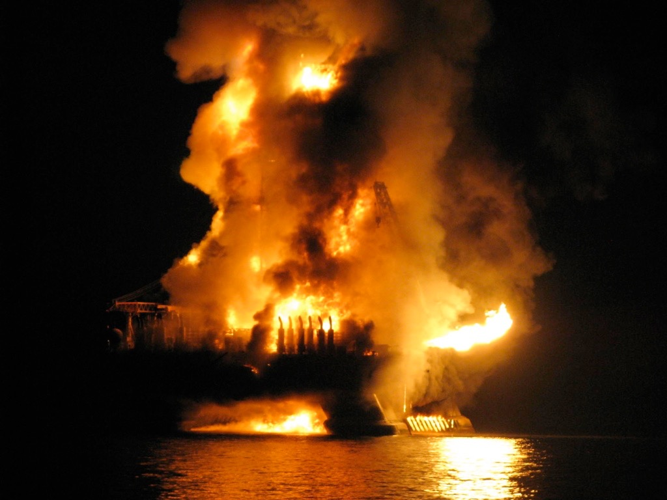
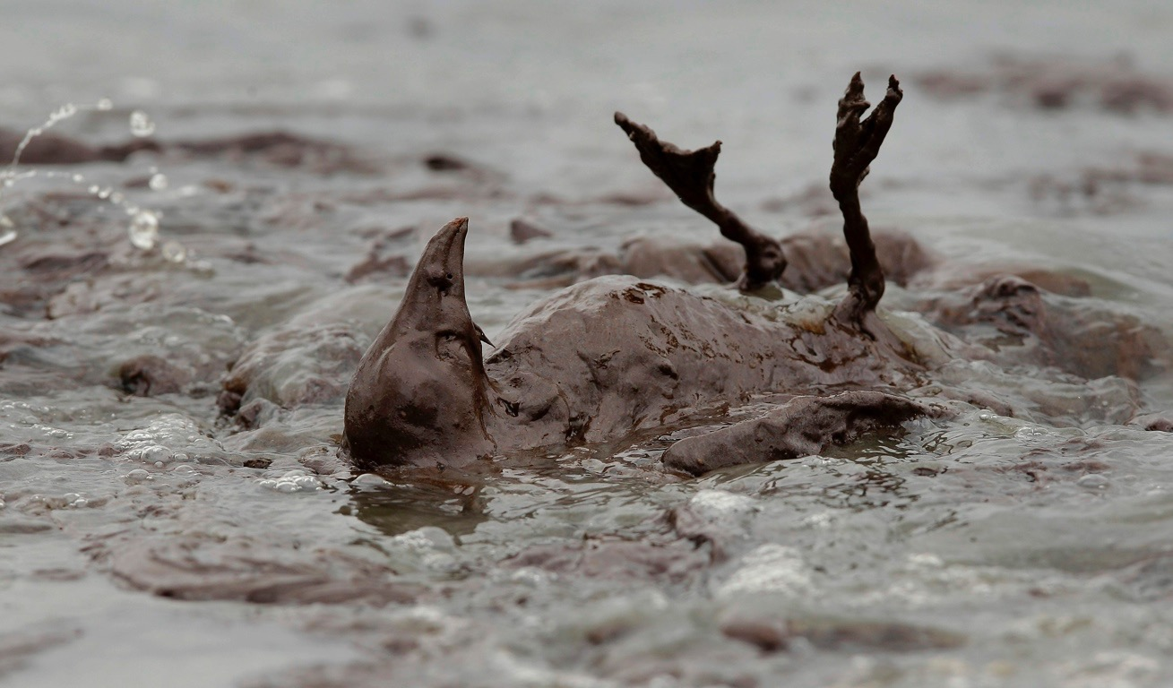
Notes:
Here’s an example.
On 20 April 2010, an oil rig exploded and caught fire off the coast of Louisiana in the US. Deepwater Horizon.
In the next few months, 750 million litres of oil spilled from the site. By some distance the biggest oil spill there’s ever been.
The scale of the impacts on wildlife in the Gulf of Mexico still isn’t fully known, but will certainly be serious.

Slide 43
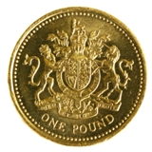
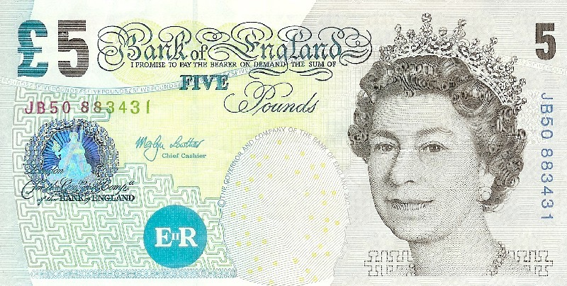
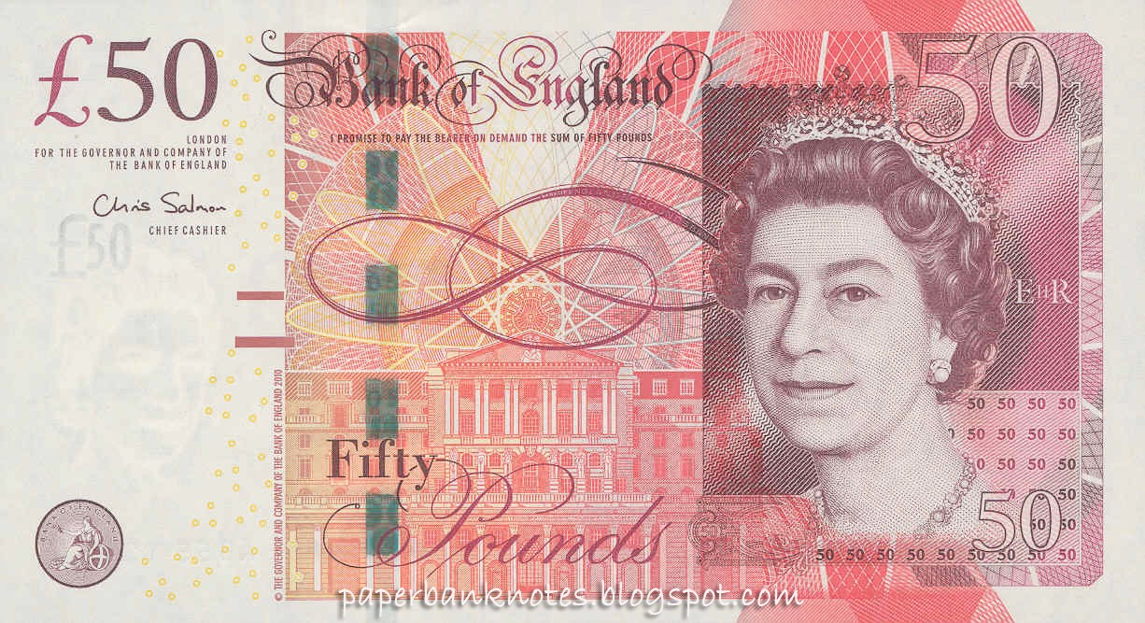
Imagine that you could have prevented the oil spill following the Deepwater Horizon explosion by paying…
Notes:
£1. Would you have paid £1 to stop that happening? (Hands)
Keep your hand up if you’d have paid £5 … £50
So we can argue that the oil spill destroyed at least that much value simply for the people in this room.
Obviously a lower (!) bound on total damage (other people to ask and other aspects to be valued!). And a horrible valuation study for all kinds of reasons…

Slide 44

Litigation
Valuation may inform fines and damages
Notes:
(3)

Slide 45
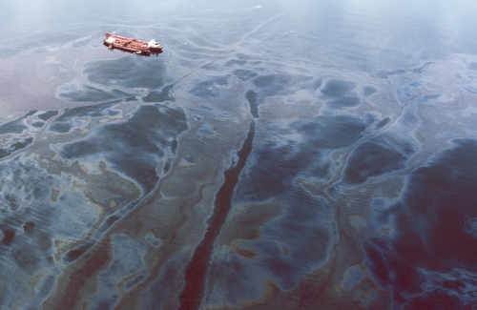
Exxon Valdez Prince William Sound, Alaska, 1989
Notes:
A famous example of litigation damages is in fact an earlier oil spill, from the tanker Exxon Valdez.
40m litres of crude oil contaminated 2000km of shoreline killing 250,000 seabirds, plus otters, seals, and other species.

Slide 46
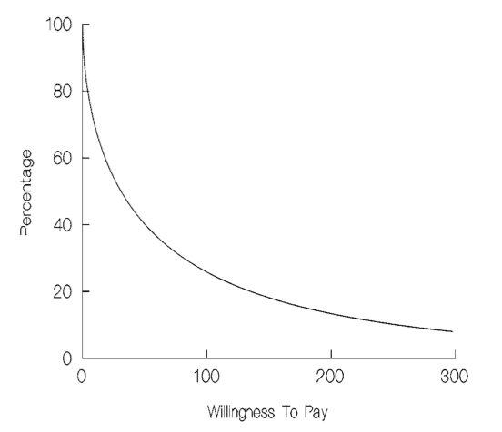
Exxon Valdez: damages
Use values
Civil suits filed by some with lost use values — e.g. fishermen
Non-use values
State of Alaska litigated
Carson et al., 1994 — stated preference study calculated WTP of English-speaking US households
$3 – 9 billion
Notes:
At the very least, one would hope that Exxon would be made to compensate all the damage caused by the spill.
Well, how do we assess that?
In terms of lost use values, some of those were pursued in civil suits by those affected. Straghtforward to calculate on basis of lost earnings.
But what about non-use values? …
State of Alaska took Exxon to court to pursue compensation for these.
Similar to valuation exercise earlier! With a more plausible scenario. (More details in SP lecture + seminar).
Excludes a lot of people’s values.
By appealing over and over again, Exxon got away with paying a lot less.
Read about this for the seminar in two weeks.

Slide 47
Green national accounting
True measures of economic growth
Valuation required to monetise pollution damage and resource depletion
See final lecture
Notes:
(5)
Valuation to monetise the damage and depletion, and subtract those from your savings or income measures.
Full lecture on this in week 12.

